Slide 1
EHG SIGNAL ANALYSIS
Ch.Sahithi-EC21B1082
M. Haritha Reddy-EC21B1091

Slide 2
Problem Statement
Feature extraction from EHG signal to detect pre term birth.
Preterm birth is defined as birth before 37 weeks of pregnancy. The World Health Organization have reported that every year about 15 million newborns are preterm, which account for more than 10% of all babies born around the world.
Preterm birth is a dominant cause for morbidity and mortality during both the perinatal and early neonatal periods. In addition, the complications of preterm birth such as significant neurological, mental, behavioral and pulmonary problems have a significant adverse impact on family and the economy.
Preterm birth is therefore both a major medical and economic challenge. One of the keys to reduce the incidence of preterm birth would be its detection or prediction using effective methods.

Slide 3
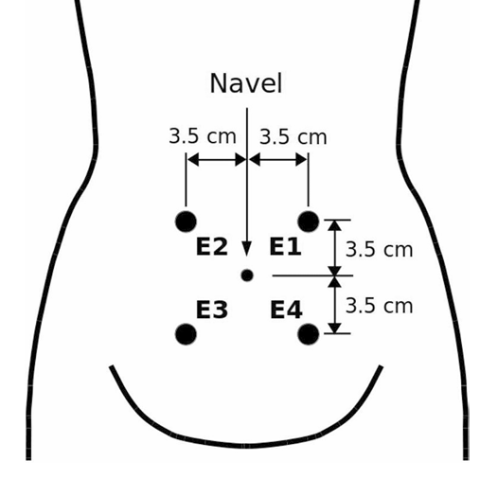
Action potential
Gap junctions are groups of proteins that provide channels of low electrical resistance between cells.
These are the origin of electrical activity in uterine muscles.This electrical activity recorded through the leads is called Electrohysterography (EHG).
The body gradually increases the number of electrical connections (gap junctions), between cells. In turn, this produces contractions.

Slide 4
Steps to extract features
Pre process the signal:
Butterworth filter :0.5-4Hz
Wavelet decomposition:
Biorthogonal wavelets
Feature extraction:
Features extracted from spectrogram
Sample entropy
Fractal dimensions

Slide 5
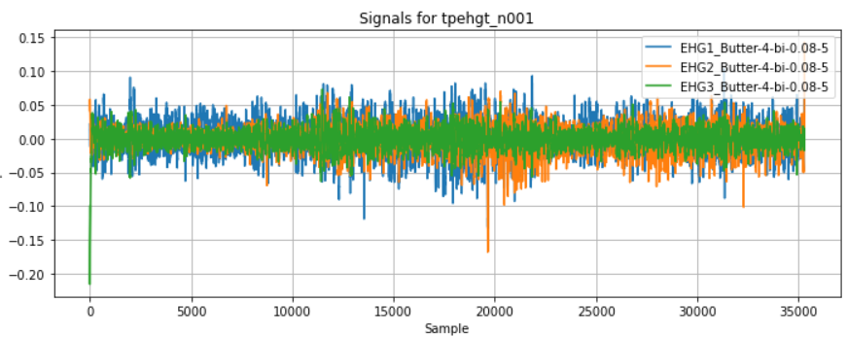
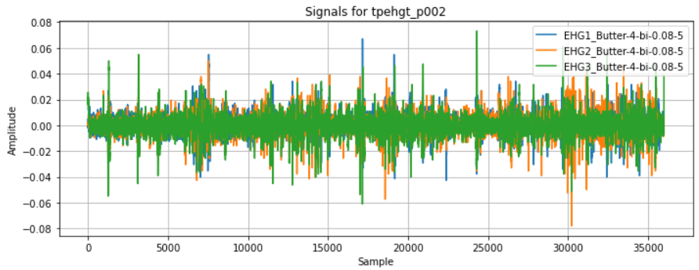
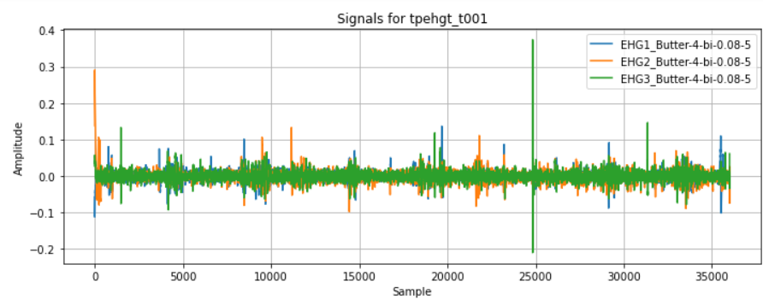
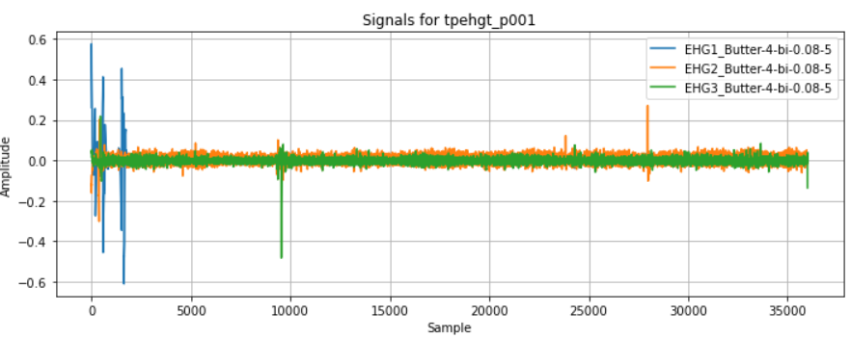
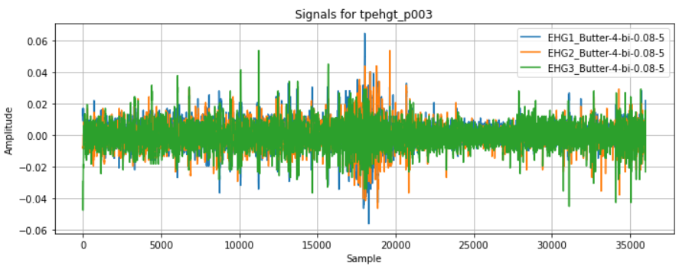
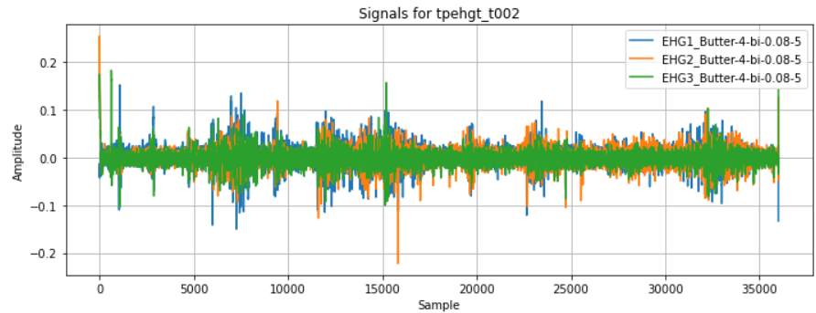
Filtered signals: normal ,preterm and term signals respectively

Slide 6
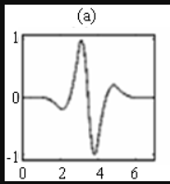
Wavelet decomposition
Biorthogonal wavelet
Wavelet decomposition is done to know the frequency components in a non stationary signal. Wavelet decomposition gives the time frequency resolution.
This helps us understand the frequency of electrical activity at a specific moment.
Biorthogonal wavelets are specifically chosen because they simplify reconstruction and do not introduce phase distortion.
Signal decomposition is done in two different levels

Slide 7
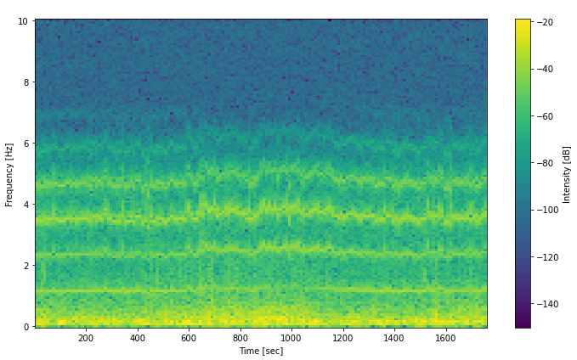
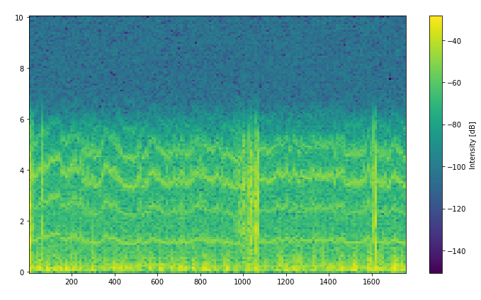
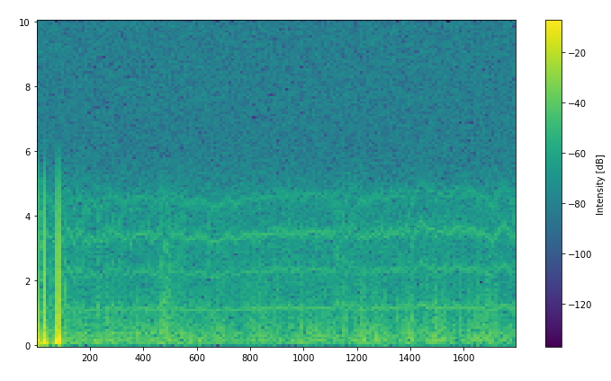
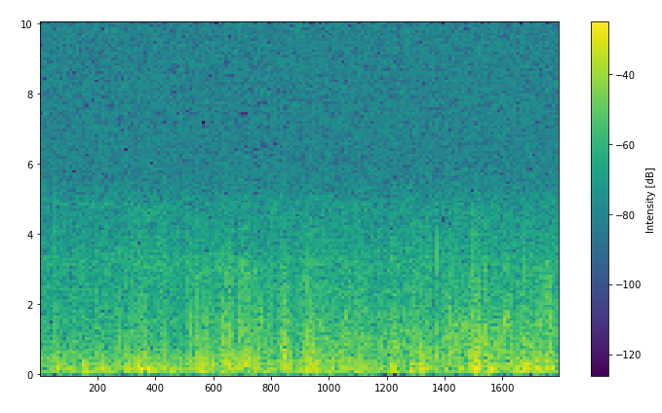
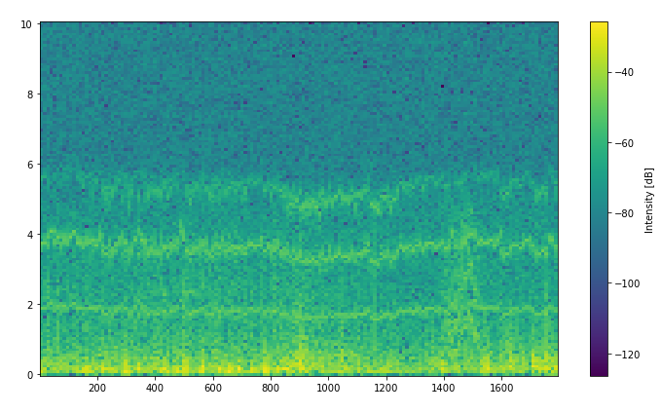
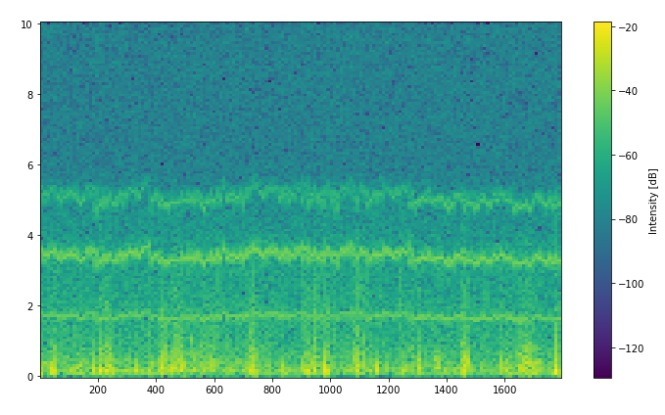
Spectrogram: gives information about time , frequency and intensity

Slide 8
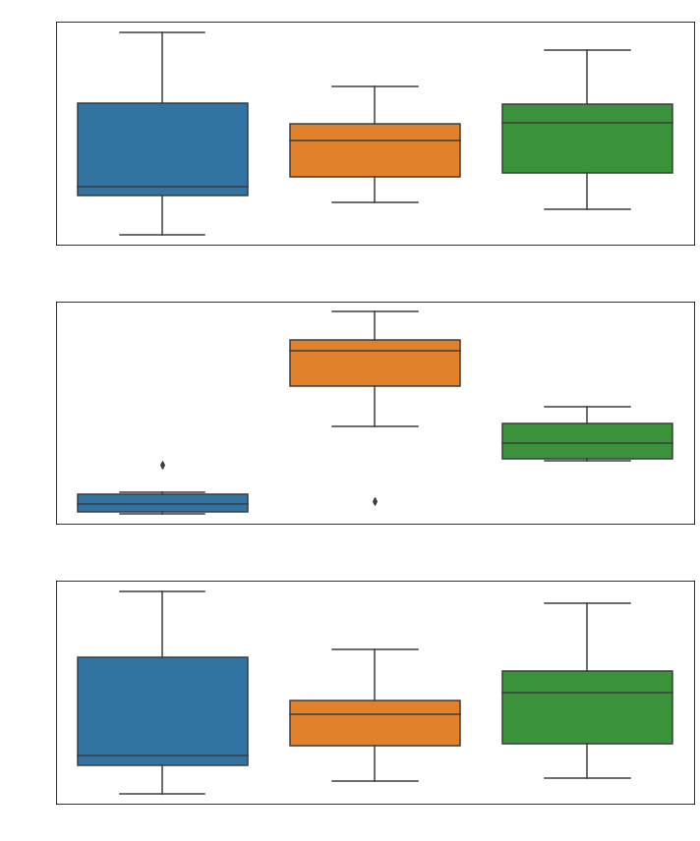
Features extracted from spectrogram:
Spectral centroid :
The spectral centroid indicates where the "center of mass" of the spectrum is located. It is often associated with the perceived brightness of a sound.
Spectral flatness:
Spectral flatness measures how flat the spectrum is. It compares the geometric mean of the power spectrum to the arithmetic mean.
Spectral Roll off:
Spectral roll off is the frequency below which a specified percentage of the total spectral energy lies. It helps in understanding the distribution of spectral energy.

Slide 9
Observations:
Higher spectral centroid values indicate that the frequencies are concentrated at higher parts of the spectrum.By comparing,
term>pre term>normal
Higher spectral flatness values indicate a more uniform spectrum, similar to white noise, whereas lower values indicate a peaky spectrum.
pre term>term>normal
Comparitively, pre term has more flatten spectrum
Lower roll off frequencies indicate that most energy is in the lower frequencies.
term>pre term>normal
Using these features we can detect pre term birth upto some extent

Slide 10
Sample entropy
Sample entropy is a metric used to quantify the complexity or regularity of a data series. It measures the likelihood that patterns in a time series that are similar will remain similar in the subsequent data points.
It works by comparing patterns of length m within the time series to each other. These patterns are compared with a tolerance or similarity threshold r. Patterns are considered similar if their absolute difference is less than r.
For each pattern of length m, sample entropy counts the number of similar patterns in the time series, then calculates the logarithm of the conditional probability that a pattern of length m+1 is similar, given that a pattern of length 𝑚 is similar. This is then averaged over all patterns.
Lower values indicates signal is regular and predictable where as higher value indicates complexity and randomness.

Slide 11
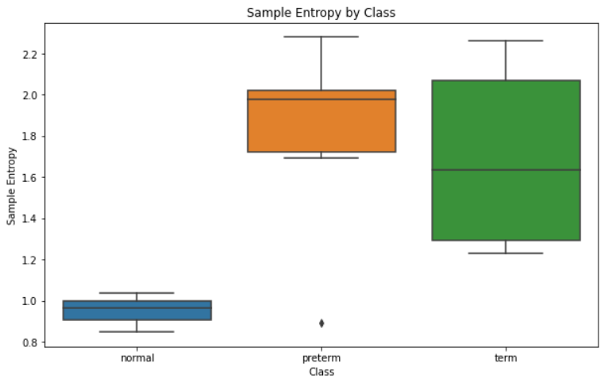
Observations:
High sample entropy indicates higher complexity and randomness
By comparision ,
pre term>term>normal
Pre term has higher complexity

Slide 12
Fractal dimensions
Fractal dimension is a metric used to quantify the complexity of fractal objects. It measures how the detail in a fractal pattern changes with the scale at which it is measured.
It works by analyzing how the number of self-similar pieces in the fractal changes with the scale. For a given fractal, the fractal dimension can be calculated using methods like box-counting, where the fractal is covered with a grid of boxes of size ε, and the number of boxes N(ε) that contain part of the fractal is counted. This process is repeated for different box sizes.
For each box size ε, the number of boxes N(ε) that cover the fractal is determined, then the logarithm of N(ε) is plotted against the logarithm of 1/ε. The slope of the resulting line gives an estimate of the fractal dimension, D. This is often expressed as:
D=limϵ→0 ​log(1/ϵ)log(N(ϵ))​
Lower values of fractal dimension indicate simpler, more regular structures, while higher values indicate more complex, intricate patterns. Fractal dimension is not necessarily an integer, reflecting the complex, often self-similar nature of fractal geometries.

Slide 13
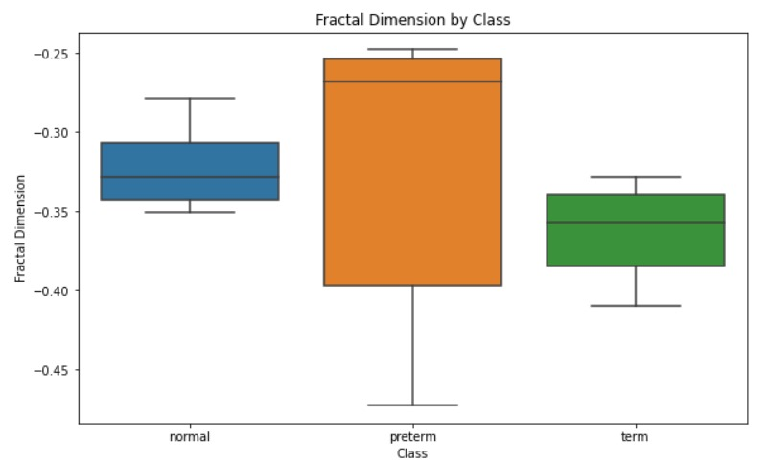
Observation:
High fractal dimension indicates higher complexity and randomness
Normal Class: Fractal dimension values for the normal class appear to be centered around -0.3 with a relatively tight interquartile range (IQR), suggesting less variability.
Preterm Class: The preterm class shows a higher median fractal dimension around -0.25, with a much wider IQR indicating greater variability.
Term Class: The term class has fractal dimension values centered around -0.32, with a moderate IQR.
By comparision ,
pre term>term>normal
Pre term has higher complexity

Slide 14
Contribution
Ch . Sahithi-
Performed wavelet decomposition over ehg signal using different wavelets and analysed that biorthogonal is good for this application.
Extracted the features from the spectrogram and sample entropy which helps in detecting pre term birth.
M . Haritha Reddy-
Performed Singular Value Decomposition (SVD) on the EHG signal data, resulting in matrices U, Σ, and 𝑉𝑇. Analysis of the singular values in Σ identified that the first few components captured the most significant patterns in the data.
In our project, we chose to utilize wavelet decomposition over Singular Value Decomposition (SVD) for analyzing EHG signals. This decision was based on wavelet decomposition's superior capability to capture both time and frequency domain features simultaneously, offering a more comprehensive representation of the signal dynamics in our analysis.".
Extracted fractal dimension features from the wavelet-decomposed signals to aid in detecting preterm birth.

Slide 15
References
https://www.ncbi.nlm.nih.gov/pmc/articles/PMC6467380/#pone.0214712.e007
https://journals.plos.org/plosone/article?id=10.1371/journal.pone.0077154
https://journals.plos.org/plosone/article?id=10.1371/journal.pone.0285219
https://www.sciencedirect.com/science/article/pii/S0031320301000954
https://www.sciencedirect.com/science/article/abs/pii/S0167865501000034
https://www.researchgate.net/publication/370402152_An_Introduction_to_Singular_Value_Decomposition

Slide 16
THANK YOU

